Slide 1
KI-FACHKONFERENZ
Artificial Intelligence Art
Jackie Ma
Sven Piechottka
Berlin,
22. Nov 2021

Slide 2
Agenda
1. Artificial Intelligence Act (AIA): Ansatz und Rezeption
2. Zusätzliche Anforderungen MDR/IVDR <> AIA
3. Ausblick: Regelungsinitiativen

Slide 3
Umfrage 1: Wissensstand zum AIA

Slide 4
Umfrage 2: Engagement für Standardisierung

Slide 5
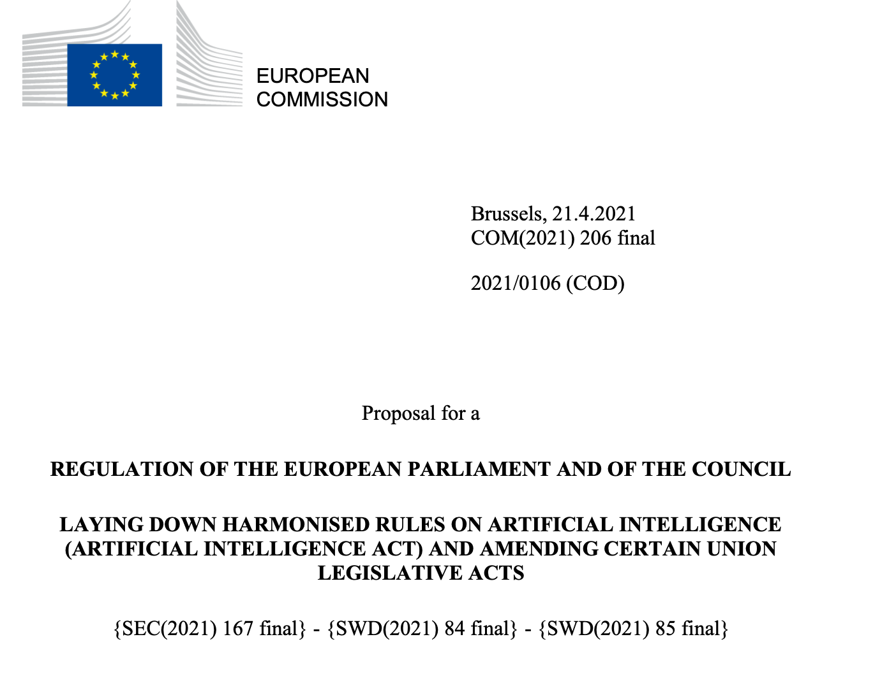
EU ARTIFICIAL INTELLIGENCE ACT
Proposes several requirements
Any AI system placed on EU market will be subject to this regulation
Currently a DRAFT regulation, i.e. some time until it goes into effect
Companies need to prepare soon to avoid future penalities or other disadvantages

Slide 6
RISK MODEL APPROACH
UNACCEPTABLE RISK e.g. AI systems that manipulate cognitive behaviour
HIGH RISK e.g. AI components in robot-assisted surgery
LIMITED RISK e.g. AI systems used in chat bots
MINIMAL RISK e.g. AI enabled spam filters

Slide 7
REGULATION PROPOSES REQUIREMENTS
UNACCEPTABLE RISK
HIGH RISK
LIMITED RISK
MINIMAL RISK
Will not be permitted.
Must undergo conformity assessment and continuously comply over lifecycle
Registered in EU database
Sign declaration of conformity
High quality of the data base
High level of robustness, security and accuracy
Logging of activity to ensure traceability of results
…
Specific transparency obligations: users should be made aware of interaction with an AI
Free use of application

Slide 8
RECEPTION
Creation of harmonized AI regulation as proposed by the EU Commission is very well endorsed
Attention has to be paid, among others, to:
  The proposal in its current form would imply any medical device software to be a high-risk AI system
  There is great potential in redundant or even conflicting regulation compared to existing regulations such as MDR/IVDR in particular in, for instance, risk management, technical documentation and conformity assessment
  Processing personal data in compliance with the AIA while not conflicting the obligation under the GDPR may, in general, pose numerous challenges to medical technology providers

Slide 9
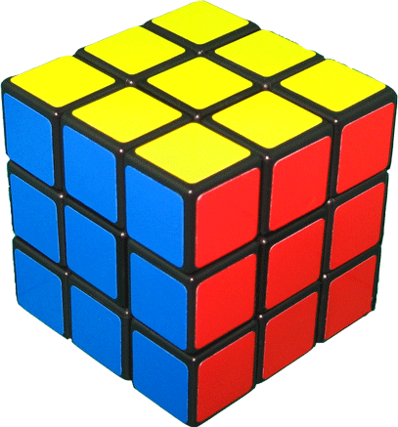
Artificial Intelligence Act (AIA): How Do Medical Devices Fit In?
“Prohibited Practices” / Rechtswidrige Praktiken, z.Bsp:
“subliminal techniques beyond a person’s consciousness in order to materially distort a person’s behavior (...)”
→ Für (heutige) Medizinprodukte vrs. nicht anwendbar
“High-Risk AI” / Hochrisikosysteme, falls beide Kriterien erfüllt sind (Art. 6 AIA):
(a) KI-System ist Sicherheitskomponente¹ eines Produktes nach Annex II
(b) Das Produkt unterliegt einem “third party assessment” zur Marktzulassung nach Annex II
→ Prognose: die meisten KI-Medizinprodukte sind Hochrisiko-Systeme und benötigen Zertifizierung
MDR/IVDR-Produkte werden im Rahmen der bisherigen Zulassungsverfahren auf AIA-Anforderungen geprüft (Art. 43 Abs. 3)
KI-Systeme unter Annex III müssen nach neuem Zulassungsverfahren (Annex VII) zugelassen werden.
Ein geringes Risiko ist vermutlich nicht anwendbar für die meisten KI-Medizinprodukte.
GDPR
MDR/IVDR
AIA
¹ Art. 3 Para. 14: means a component of a product or of a system which fulfils a safety function for that system / product or the failure / malfunctioning of which endangers health and safety of persons or property.

Slide 10
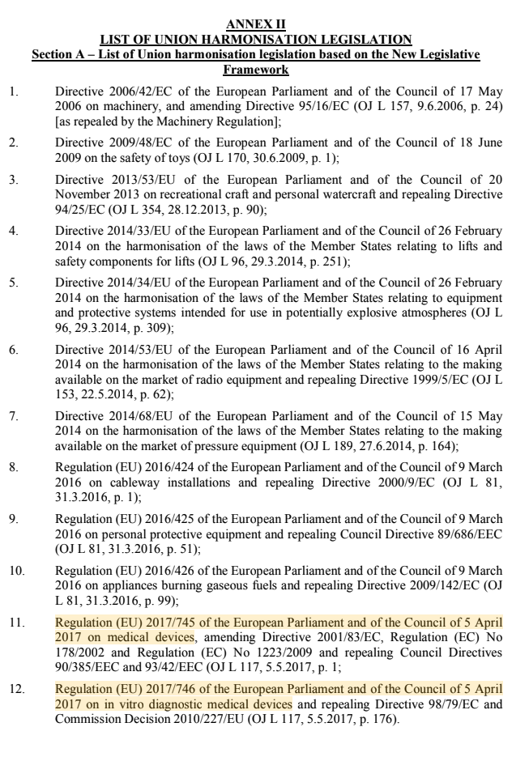
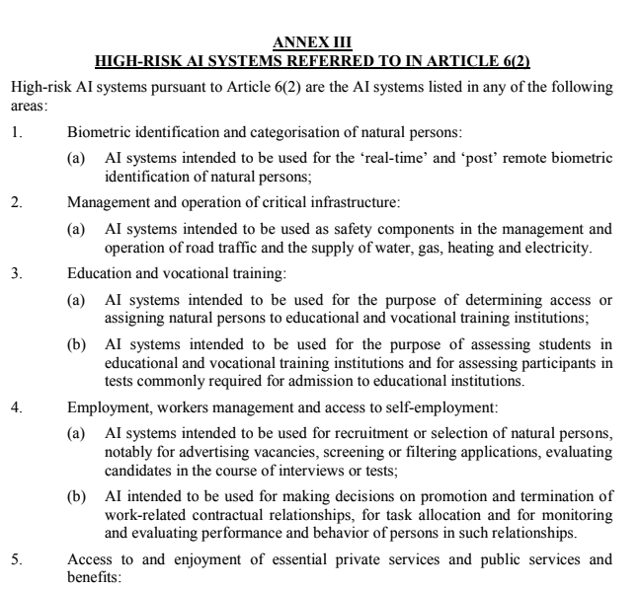

Slide 11
Umfrage 3: AIA Klassifizierung - Implikationen

Slide 12
Anforderungen MDR/IVDR <> Artificial Intelligence Act (AIA)
Allgemeine Herstellerpflichten (Art. 16, 17)
  Lernende Systeme: Art. 43(4) <> FDA
Risikomanagement-System (Art. 9)
Data Governance (Art. 10)
Technische Dokumentation (Art. 11, Annex IV)
  Neu: Trainingsmethoden, Datenauswahl, Labelling Prozess, etc.
Aufzeichnungen / “Logging” (Art. 12)
Transparenz & Nutzerinformationen
(Art. 13, 52)
Menschliche Aufsicht (Art. 14)
Genauigkeit, Robustheit, IT-Sicherheit (Art. 15)
Anforderungen an Betreiber (Art. 25, 28)
Post-Market Surveillance (Art. 61)

Slide 13
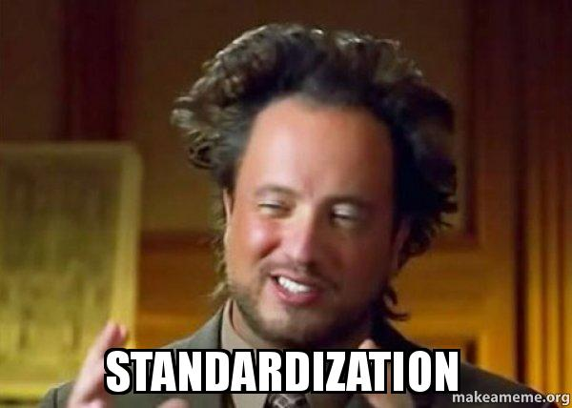
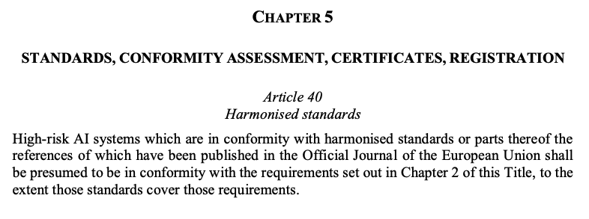

Slide 14

Harmonisierte KI-Normen: Quo Vadis?
International Medical Device Regulators Forum (IMDRF)
KI-Arbeitsgruppe im Herbst 2020 gegründet
Entwurf KI-Glossar
Standardisierungsorganisationen
ISO/IEC JTC1, SC 42 (Artificial Intelligence)
ISO/IEC TC215 (Health Informatics)
Institute of Electrical and Electronics Engineers (IEEE):
  P2802 (Evaluation of AI-Based MD), P2801 (QM of Medical AI Datasets), P7003 (Algo Bias Considerations)
Consumer Technology Association (CTA):
  ANSI/CTA 2089.1 (AI Definitions in Healthcare), ANSI/CTA 2090 (Trustworthiness)
AAMI & BSI haben KI-Arbeitsgruppe gegründet (Positionspapier 05/2020)

Slide 15
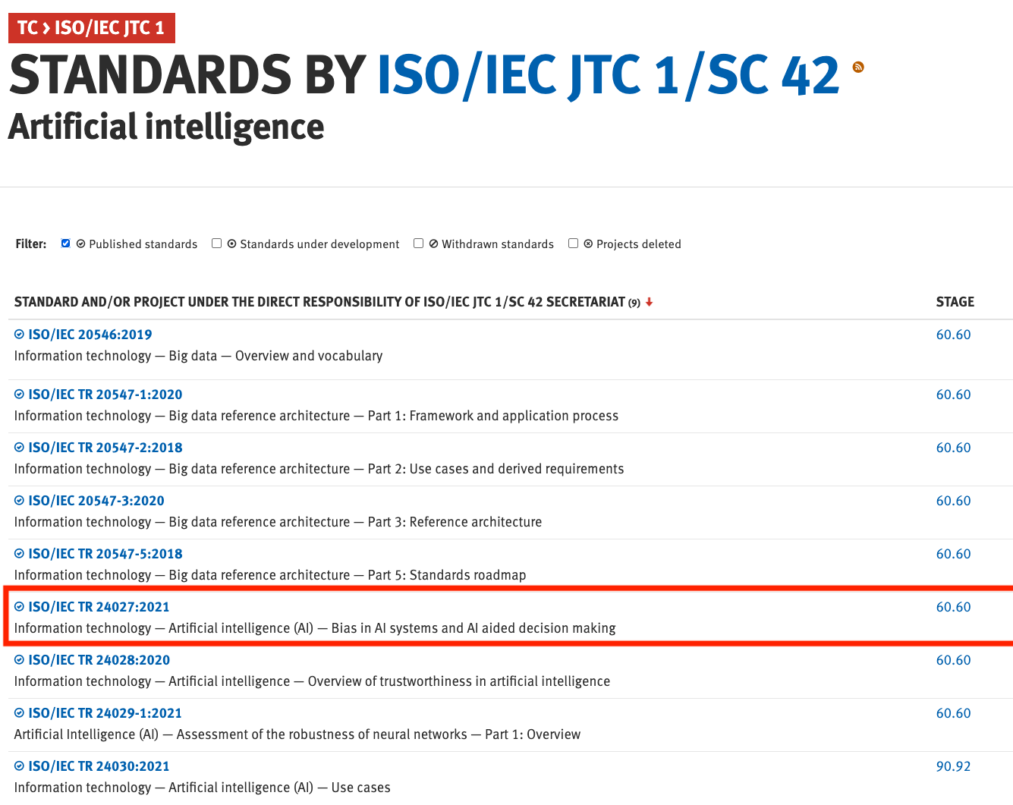
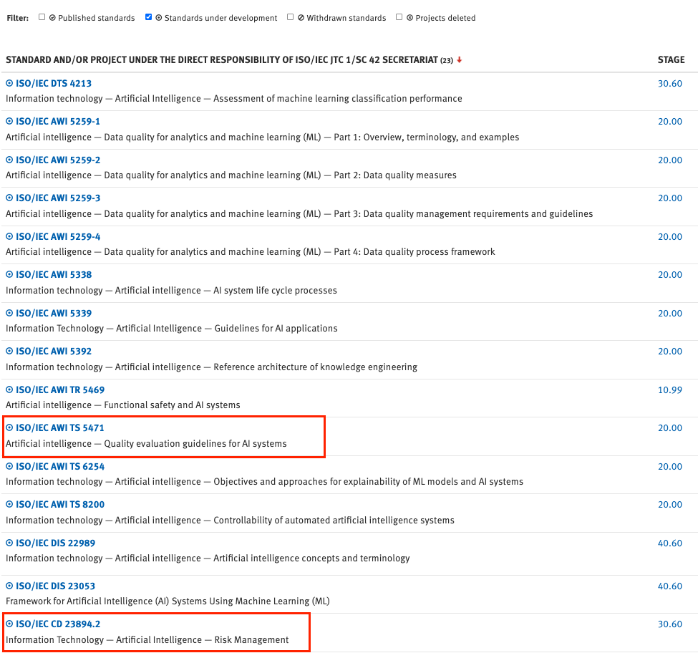

Slide 16
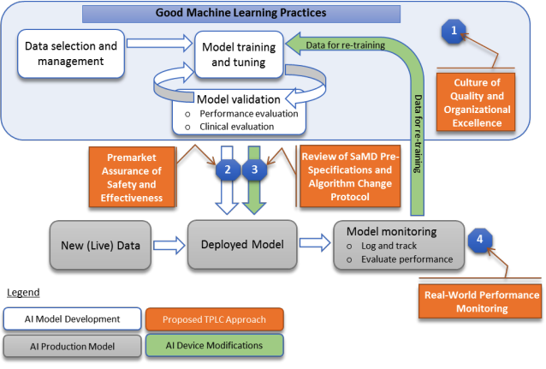
Harmonisierte KI-Normen: Quo Vadis? Part II
United States Food and Drug Administration (FDA)
04/2019: Regulatory Framework for Modifications to AI/ML-Based SaMD (Link)
MDIC Projekt: Templates / Whitepaper für SPS/ACP (Link)
01/2021: FDA Action Plan on Artificial Intelligence (Link)
Andere staatliche Initiativen
Südkorea Guideline (04/2020)
China NMPA, Singapur (10/2021), Saudi-Arabien (02/2021)
Andere nicht-staatliche Initiativen
WHO/ITU Focus Group “AI4Health”
Xavier University “Good Machine Learning Practices” WG
Pistoia Alliance

Slide 17

Vielen Dank für
Ihre Aufmerksamkeit!
Ihr Ansprechpartner:
Jackie Ma
Head of Applied Machine Learning Group
Fraunhofer HHI
E-Mail: jackie.ma@hhi.fraunhofer.de
Ihr Ansprechpartner:
Sven Piechottka
Medizinprodukteberater
Open Regulatory GmbH
E-Mail: sven@openregulatory.com

Slide 18
Umfrage 4: Klärungsbedarf?

